Slide 1
Ethics in Data Science
By: Romeo Dandison

Slide 2
Table of contents
Ethics in Data science
Principles of data ethics
01
02
Importance of ethical data usage
Data Privacy & Laws
03
04
Introducing concepts
Concerns in data and ethics
Key importance in data usage
Legislations
Responsible Data Usage
04
Key practices

Slide 3
01
Ethics in Data Science
Introducing the concept of ethics in data science

Slide 4
What is Ethics in Data Science?
Ethics in Data Science refers to the responsible and ethical use of the data throughout the entire data lifecycle. This includes the collection, storage, processing, analysis, and interpretation of various data. Further, data ethics attempt to maintain the trust of parties such as consumers, users, clients, patients, employees, and partners.

Slide 5
02
Principles of Data Ethics
Working with data ethically involves adhering to certain principles as ;

Slide 6
Principles of Data Ethics
Privacy
Accountability
Transparency
Security
Fairness and Bias
Data Quality
P
A
Respecting an individual’s data with confidentiality and consent.
Hold individuals and organizations accountable for their actions and decisions.
T
PTFASD
S
Communicating how data is collected, processed and used.
Implementing robust security measures that protects data collected from unauthorized access.
F
D
Ensuring fairness in data-driven processes and addressing biases that may arise & preventing discrimination .
Ensures the accuracy of data, completeness and the reliablity of the data to preventmisinformation.

Slide 7
03
Importance of Ethical usage
Benefits associated with ethical usage of data

Slide 8
Importance of Ethical Usage of Data
Certain business advantages of adhering to ethical principles also exist. For example, businesses that follow ethical principles can:
Build trust and goodwill with their customers
Reduce the risk of unintended bias and show that their decision-making is fair
Ensure that they comply with legal requirements
Attract high-quality employees
Boost customer loyalty and profitability

Slide 9
04
Data Privacy & Laws
Legal and Regulatory Frameworks

Slide 10
Data Privacy and Laws
As more and more social and economic activities have place online, the importance of privacy and data protection is increasingly recognized.
Of equal concern is the collection, use and sharing of personal information to third parties without notice or consent of consumers. 137 out of 194 countries had put in place legislation to secure the protection of data and privacy.
Africa and Asia show different level of adoption with 61 and 57 per cent of countries having adopted such legislations. The share in the least developed countries in only 48 per cent.

Slide 11
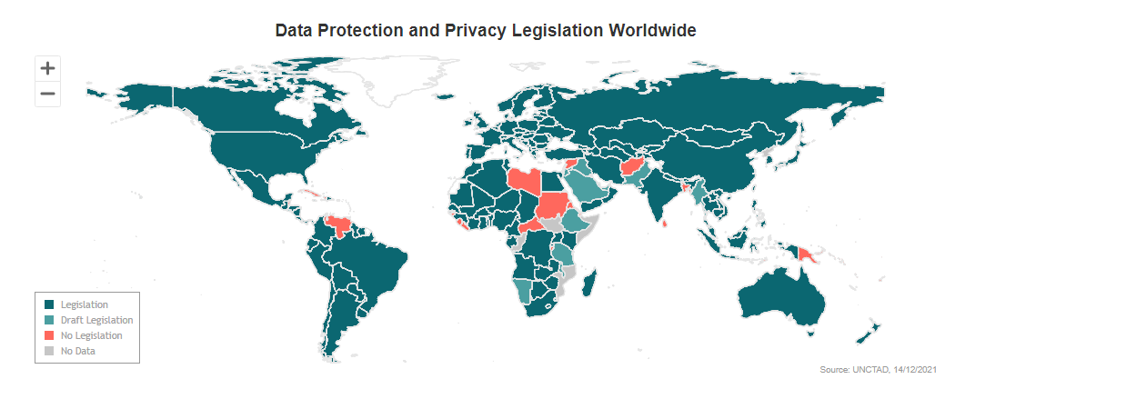

Slide 12
05
Responsible Data Usage
Key practices

Slide 13
Key Practices for Responsible Data Usage
Transparency & Documentation
Clearly outline and document the following; Data sources, methodologies and transformations
Bias Mitigation
Identifiying and mitigating biases in data and algorithms through data audits, algorithm fairness and diverse representation
Data Privacy and consent
Respecting data privacy laws and obtaining informed consents, anonymization of identifiable information where possible and compliance to legal frameworks

Slide 14
Key Practices for Responsible Data Usage – cont’d
Security
Safeguarding against data breaches and unathorized access through encryption, access control and regular audits
Ethical Decision-Making
Considering the broader ethical implications of data usages through societal impact assessment, continous evaluation

Slide 15
Conclusion
The ethical considerations in data science are pivotal, shaping how data is collected, analyzed, and utilized. By embracing responsible and ethical data practices, Data Scientists not only ensure compliance with regulations but also contribute to building trust, promoting fairness, and fostering positive societal impacts.
In essence, the ethical use of data isn’t just a professional requirement; it’s a commitment to harnessing the power of data for the collective good while safeguarding individual rights and societal values.

Slide 16
References
https://unctad.org/page/data-protection-and-privacy-legislation-worldwide retrieved on August 14th, 2024
https://online.maryville.edu/online-masters-degrees/data-science/careers/data-science-ethics-issues-and-strategies/ retrieved on August 14th, 2024

Slide 17
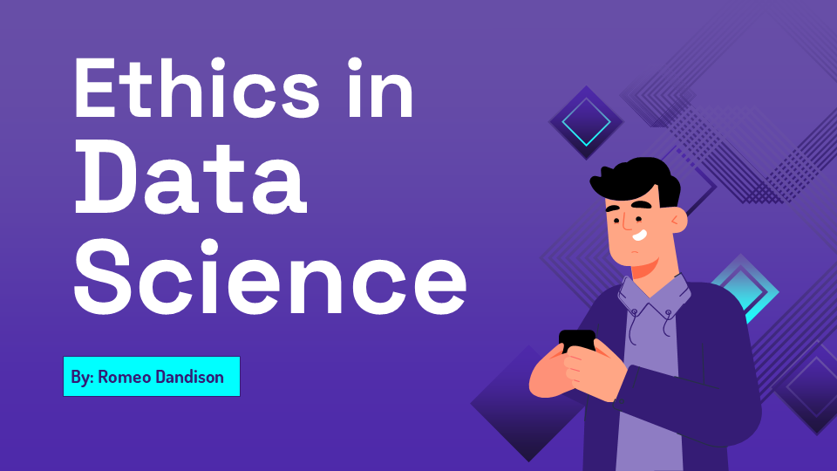
Thanks!

